Slide 1

POKEMON DATA SET
PUSHPRAJ SINGH RATHORE

Slide 2
Introducation
Pokemon holds a very special place in my heart as it is probably the only video game I have judiciously followed for more than 5 years. With this dataset, I wanted to be able to explain some operation .

Slide 3
About Dataset
Context
This dataset contains information on all 802 Pokemon from all Seven Generations of Pokemon. The information contained in this dataset include Base Stats, Performance against Other Types, Height, Weight, Classification, Egg Steps, Experience Points, Abilities, etc

Slide 4
With this dataset, I wanted to be able to answer the following questions
Which type is the strongest overall? Which is the weakest?
Which type is the most likely to be a legendary Pokemon?

Slide 5
#This code help import Csv file and we have store a Pokemon data in ("a")Varilabe
a=read.csv("Pokemon.csv",TRUE,",")
class(a)
a
View(a)
#ncol(a) to find how many columes are the table
ncol(a)
#nrow(a) is use to find how many colume are the table
nrow(a)
Out put
Coloum-41
Row-801
#table(a$is_legendary) this code represnt 0 value is 731 and 1=70
table(a$is_legendary)
output 0=731
1=70

Slide 6
# this code is show that how many Pokémon character in type 1 and type 2table
table(a$type1)
table(a$type2)
Out put
>type1 table
bug dark dragon electric fairy fighting fire flying
72 29 27 39 18 28 52 3
ghost grass ground ice normal poison psychic rock
27 78 32 23 105 32 53 45
steel water
24 114
>type2 table
bug dark dragon electric fairy fighting fire
384 5 21 17 9 29 25 13
flying ghost grass ground ice normal poison psychic
95 14 20 34 15 4 34 29
rock steel water
14 22 17

Slide 7
# min max opreration
min(a$type1)
max(a$type1)
Output
[1] "bug“
[1] "water"
#is.na(a$abilities) this code is to find a null have but there no null value
is.na(a$abilities)
output
[1] FALSE FALSE FALSE FALSE FALSE FALSE FALSE FALSE FALSE FALSE FALSE FALSE FALSE FALSE FALSE FALSE FALSE FALSE FALSE
[20] FALSE FALSE FALSE
#to cheak the null value is there
sum(is.na(a$abilities))
output
[1] 0

Slide 8
#to find colname pokemon and change the colnames type1 is primary typ2 secodnary
colnames(a)
colnames(a)[colnames(a)=='type1']<-"primary"
colnames(a)[colnames(a)=='type2']<-"secondary"
Output
[1] "abilities" "against_bug" "against_dark" "against_dragon" "against_electric"
[6] "against_fairy" "against_fight" "against_fire" "against_flying" "against_ghost"
[11] "against_grass" "against_ground" "against_ice" "against_normal" "against_poison"
[16] "against_psychic" "against_rock" "against_steel" "against_water" "attack"
[21] "base_egg_steps" "base_happiness" "base_total" "capture_rate" "classfication"
[26] "defense" "experience_growth" "height_m" "hp" "japanese_name"
[31] "name" "percentage_male" "pokedex_number" "sp_attack" "sp_defense"
[36] "speed" "type1" "type2" "weight_kg" "generation"

Slide 9
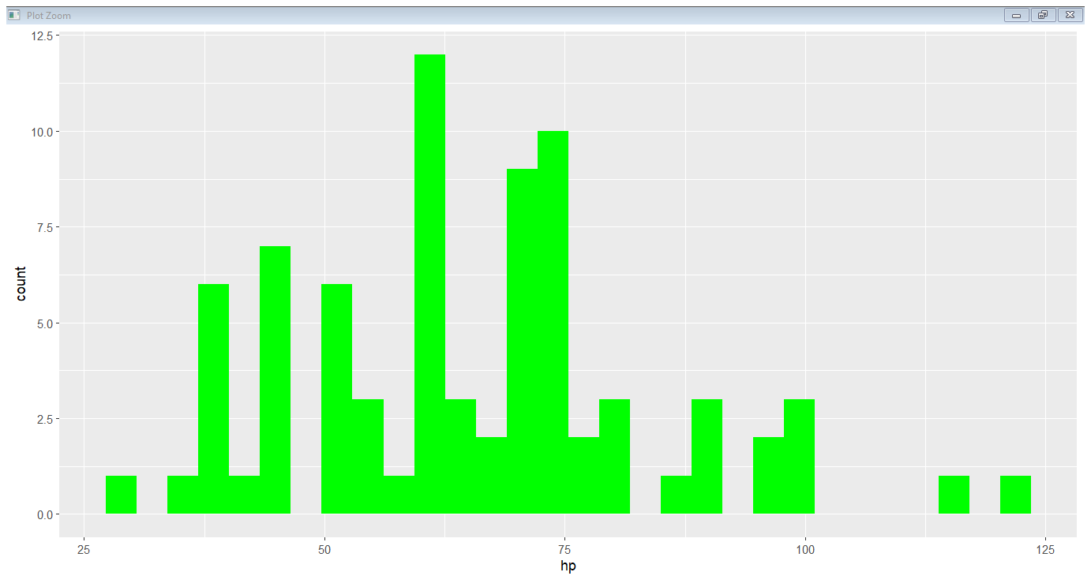
# To apply filteres and lodae package
library(tidyverse)
library(dplyr)
a %>% filter(primary == "grass")->grass
View(grass)
Output – run the code and Check data set
#mean
mean(grass$sp_defense)
Output
69.23077
# visualization
library(ggplot2)
ggplot(data=grass, aes(x=hp,)) + geom_histogram(fill="green")

Slide 10
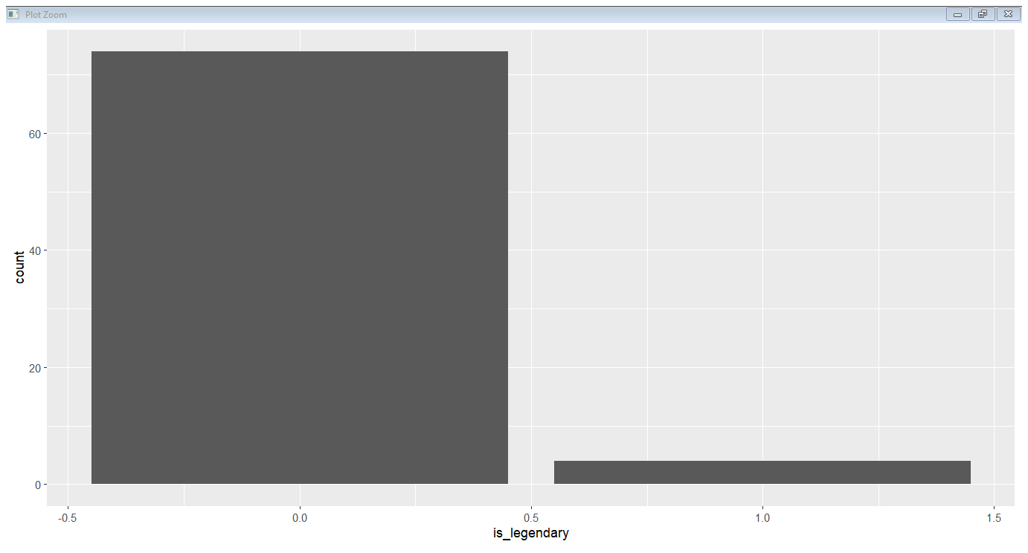
#how much Pokemon are Legendary
ggplot(data=grass,aes(x=is_legendary))+geom_bar()

Slide 11
# we have to change Primary Coloum value in fire
a %>% filter(primary == "fire")->fire_a
View(fire_a)
min(fire_a$sp_attack)
max(fire_a$sp_defense)
min(fire_a$speed)
mean(fire_a$sp_defense)
Output
[1] 15
[1] 154
[1] "no“
[1] 71.53846

Slide 12
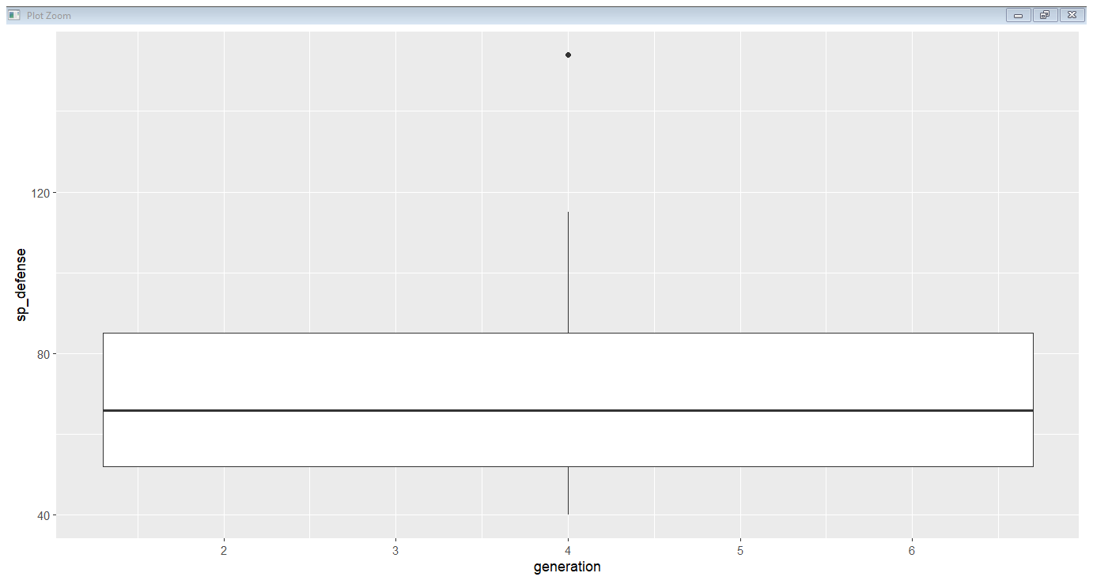
# plot normal box plotgraph on fire
ggplot(data=fire_a, aes(x=generation,y=sp_defense)) + geom_boxplot()

Slide 13
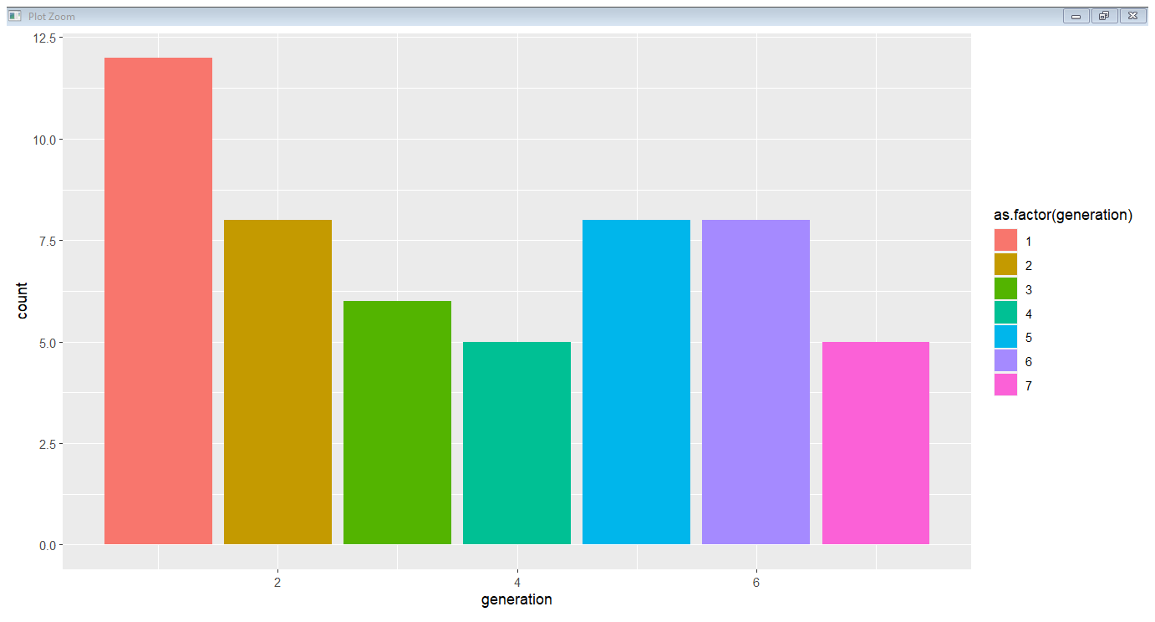
#plot colour bar graph
ggplot(data=fire_a, aes(x=generation,fill=as.factor(generation))) + geom_bar()

Slide 14
# wate Pokemon
a %>% filter(primary =="water")->water_a
View(water_a)
min(water_a$sp_attack)
max(water_a$sp_defense)
min(water_a$speed)
mean(water_a$sp_defense)
mean(water_a$sp_attack)
Output
[1] 10
[1] 160
[1] "no“
[1] 71.79825
[1] 74.0614

Slide 15
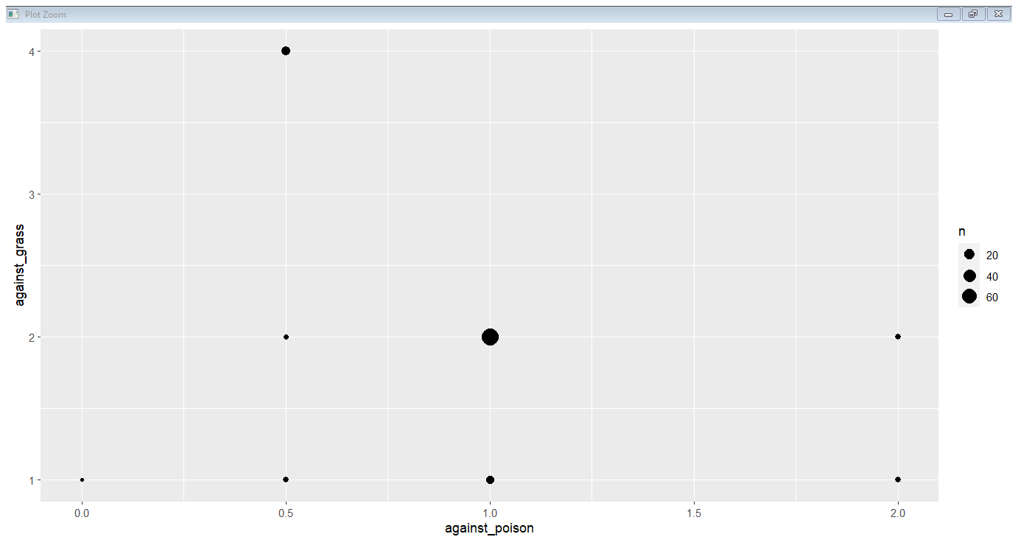
ggplot(data=water_a,aes(x=against_poison,y=against_grass))+geom_count()

Slide 16
THANK YOU

